Slide 1
Denoising Diffusion Models:
A Generative Learning Big Bang
Lecturer: Shangsong Liang
SYSU
1
Notes:
From: https://cvpr2023-tutorial-diffusion-models.github.io/
Produced by Jiaming Song, Chenlin Meng, and Arash Vahdat
Modified by S Liang, Do NOT redistributed without the original authors’ permissions.

Slide 2
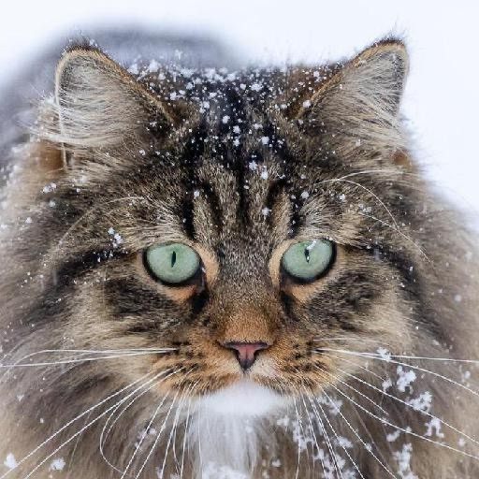
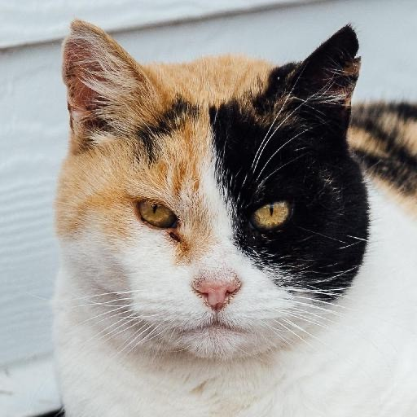
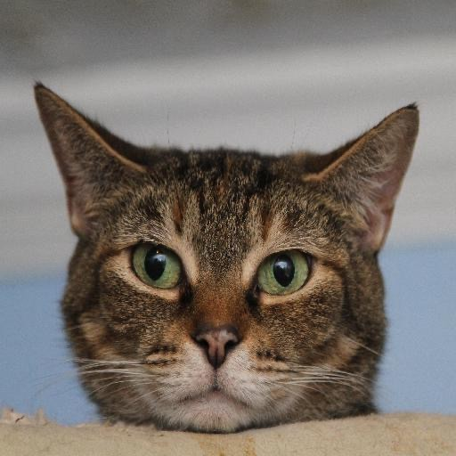

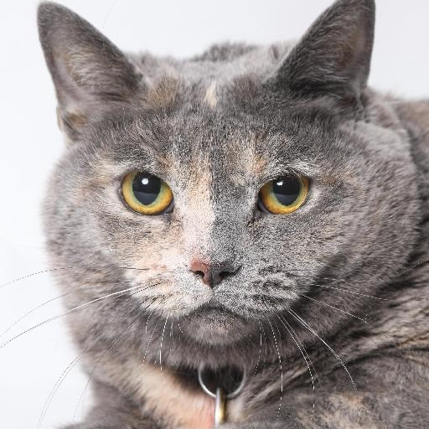
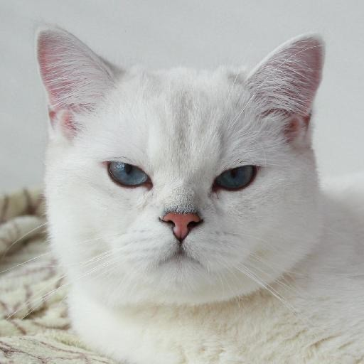
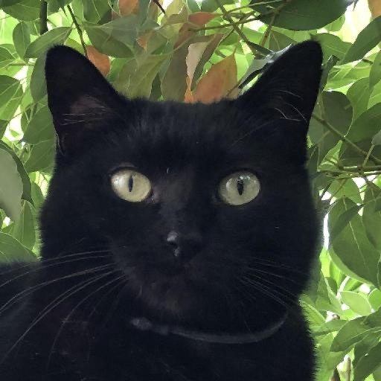

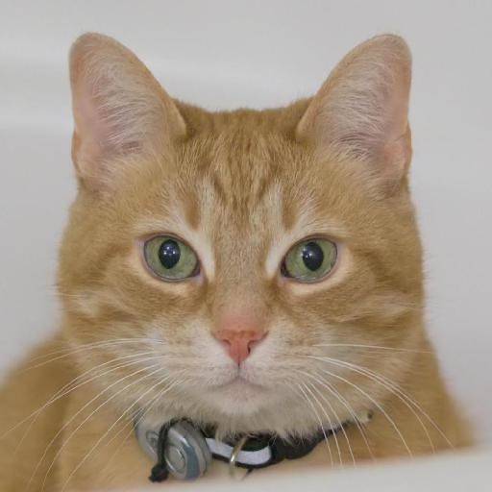
Deep Generative Learning
Learning to generate data
Train
Samples from a Data Distribution
Neural Network
Sample

Slide 3
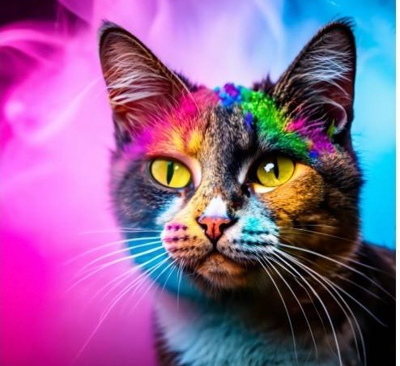
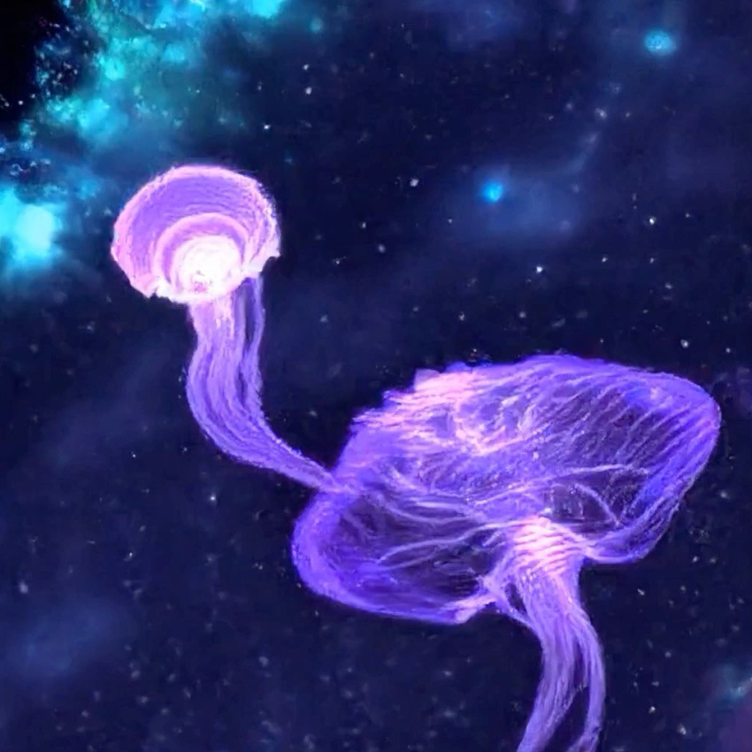
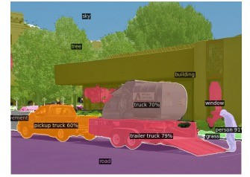
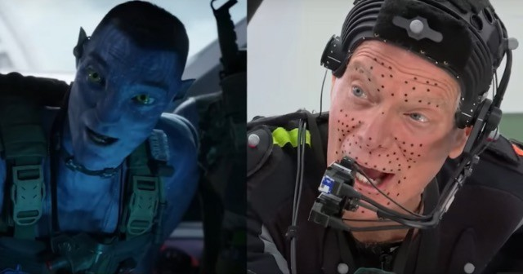
Generative Learning Applications
Art & Design
Content Generation
Representation Learning
Entertainment

Slide 4




The Landscape of Deep Generative Learning
Restricted Boltzmann Machines
Bayesian Networks
Variational Autoencoders
Normalizing Flows
Energy-based Models
Generative Adversarial Networks
Autoregressive Models
Denoising Diffusion Models
4

Slide 5
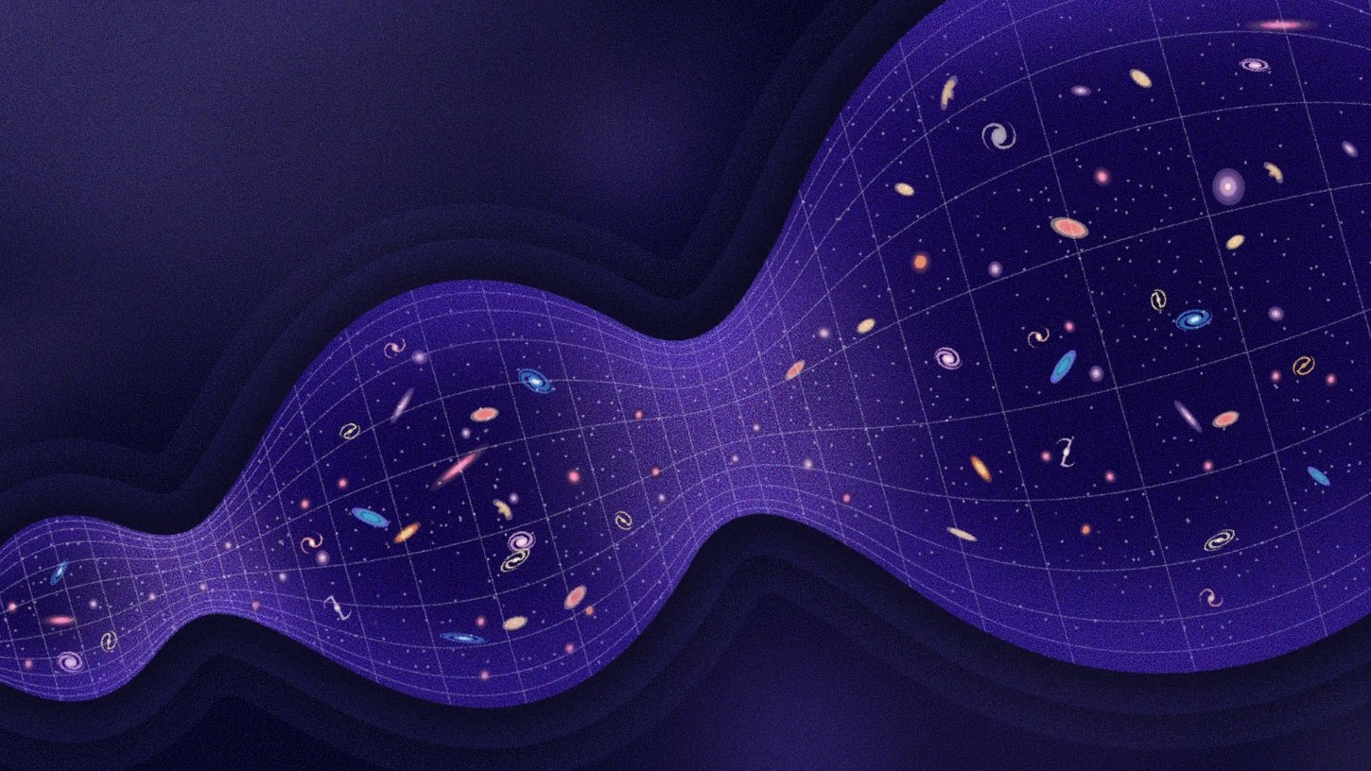




Denoising Diffusion Models:
A Generative Learning Big Bang
Big Bang!
Big Bang!
Source: https://www.wired.com/story/what-if-the-big-bang-was-actually-a-big-bounce/
5

Slide 6
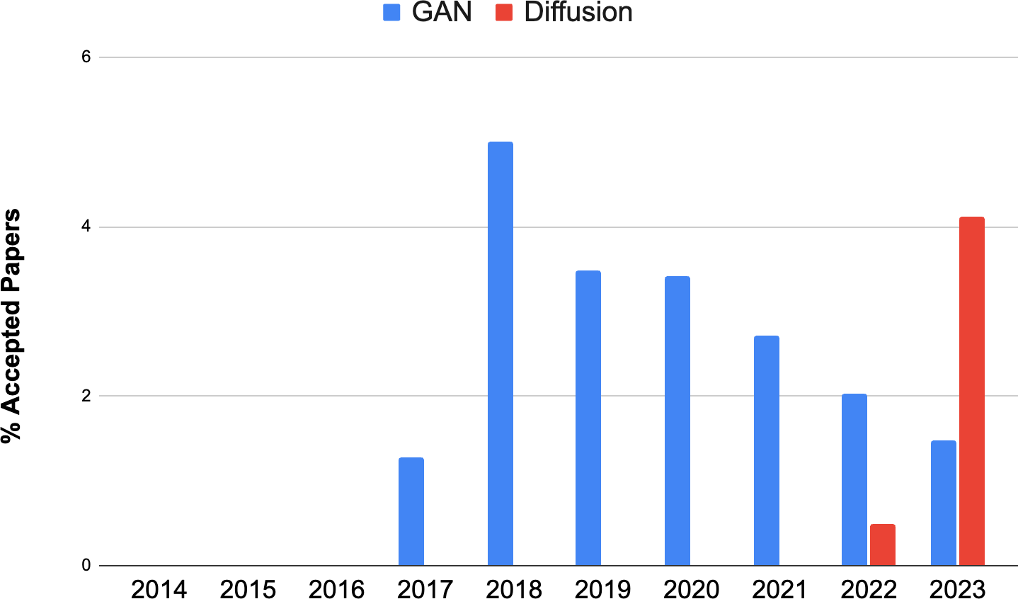
We May Not Know Cosmology, But We Know CVPR
DCGAN
Big GAN
StyleGAN
DDPM
Original GAN
Progressive GAN
Latent Diffusion
Guided Diffusion
*Disclaimer: We rely on paper titles for counting the number of papers in each topic. Our statistics are likely to be biased.
6

Slide 7
Outline
Part (1): Denoising Diffusion Probabilistic Models
Part (2): Score-based Generative Modeling with Differential Equations Part (3): Accelerated Sampling
Part (4): Conditional Generation and Guidance

Slide 8
Outline
Part (1): Denoising Diffusion Probabilistic Models
Part (2): Score-based Generative Modeling with Differential Equations Part (3): Accelerated Sampling
Part (4): Conditional Generation and Guidance

Slide 9
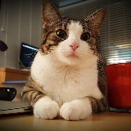
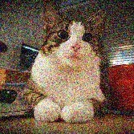
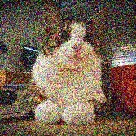
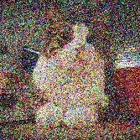
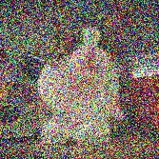
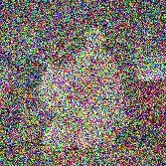
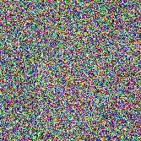
Denoising Diffusion Models
Learning to generate by denoising
Denoising diffusion models consist of two processes:
Forward diffusion process that gradually adds noise to input
Reverse denoising process that learns to generate data by denoising
Forward diffusion process (fixed)
Data
Noise
Reverse denoising process (generative)
Sohl-Dickstein et al., Deep Unsupervised Learning using Nonequilibrium Thermodynamics, ICML 2015 Ho et al., Denoising Diffusion Probabilistic Models, NeurIPS 2020
Song et al., Score-Based Generative Modeling through Stochastic Differential Equations, ICLR 2021
13

Slide 10
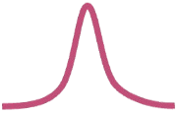

Forward Diffusion Process
The formal definition of the forward process in T steps:
Forward diffusion process (fixed)
Data
Noise
x₀
x₁
x₂
x₃
x₄
…
x_{T}
(joint)

Slide 11
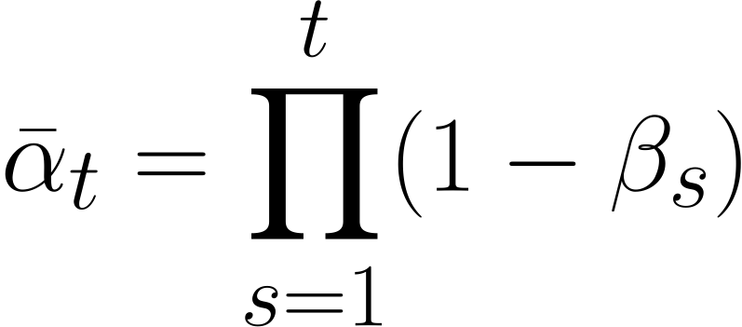
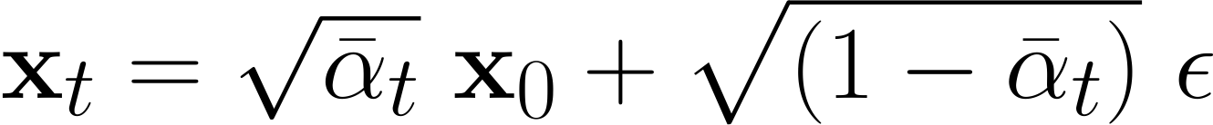
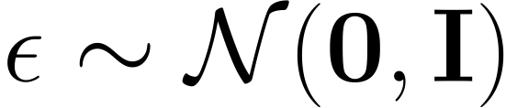

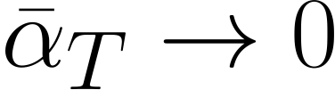
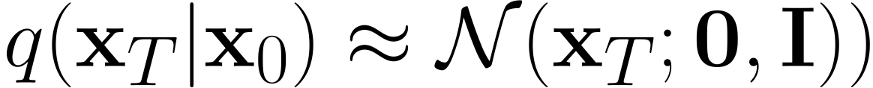
Diffusion Kernel
Forward diffusion process (fixed)
Data
Noise
x₀
x₁
x₂
x₃
x₄
…
x_{T}
Define
For sampling: where
values schedule (i.e., the noise schedule) is designed such that
(Diffusion Kernel)
and

Slide 12
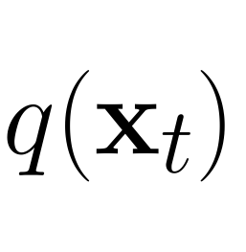
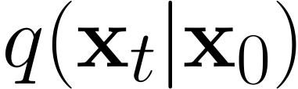
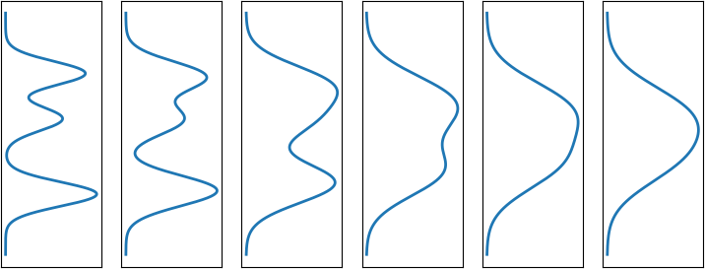
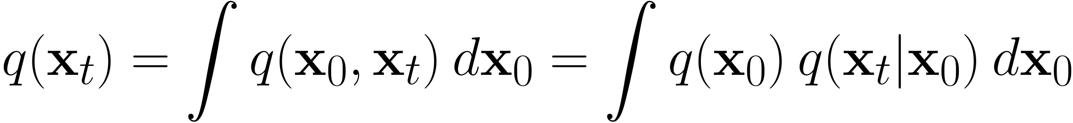
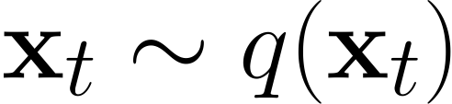
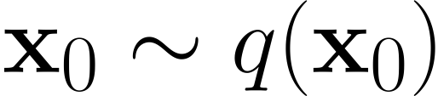
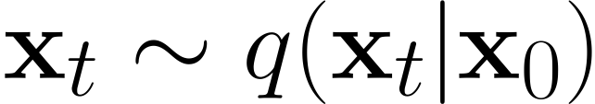
What happens to a distribution in the forward diffusion?
So far, we discussed the diffusion kernel
but what about
?
Diffused Data Distributions
Data
Noise
x_{t}
Diffused data dist.
Joint dist.
Input data dist.
Diffusion kernel
The diffusion kernel is Gaussian convolution.
q(x₀)
q(x₁)
q(x₂)
q(x₃)
…
q(x_{T})
We can sample
by first sampling
and then sampling
(i.e., ancestral sampling).

Slide 13
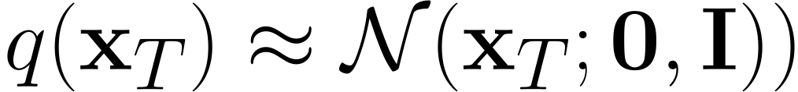
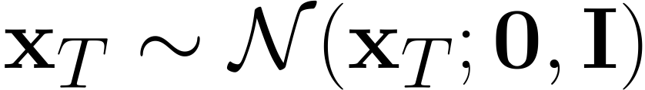
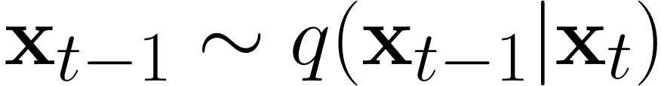





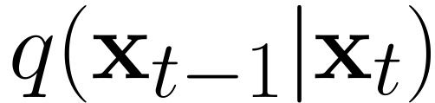

Generative Learning by Denoising
Recall, that the diffusion parameters are designed such that
Diffused Data Distributions
Generation:
Sample
x_{t}
Iteratively sample
True Denoising Dist.
q(x₀)
q(x₁)
q(x₂)
q(x₃)
…
q(x_{T})
q(x₀|x₁)
q(x₁|x₂)
q(x₂|x₃)
q(x₃|x₄)
q(x_{T-1}|x_{T})
Can we approximate
? Yes, we can use a Normal distribution if
is small in each forward diffusion step.
18

Slide 14
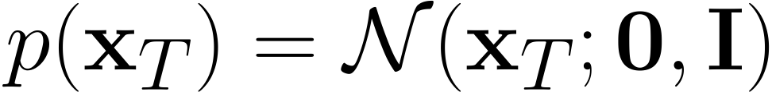
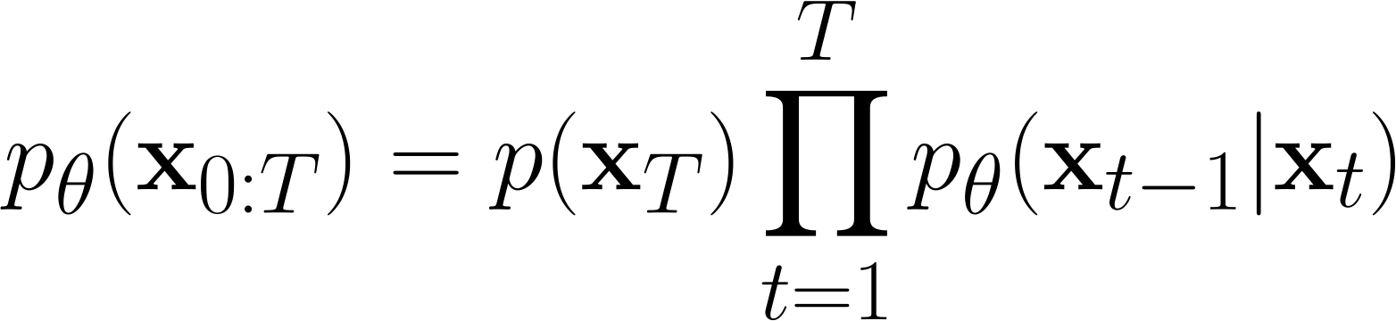
Reverse Denoising Process
Formal definition of forward and reverse processes in T steps:
Reverse denoising process (generative)
Data
Noise
x₀
x₁
x₂
x₃
x₄
…
x_{T}
Trainable network
(U-net, Denoising Autoencoder)
19

Slide 15
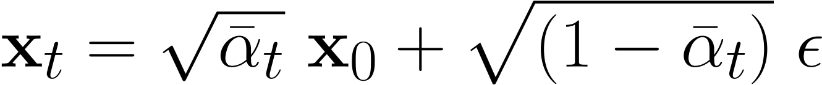
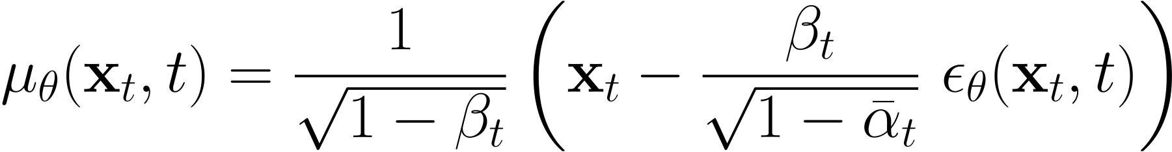
Learning Denoising Model
Variational upper bound
For training, we can form variational upper bound that is commonly used for training variational autoencoders:
Recall that
. Ho et al. NeurIPS 2020 parameterized the mean of denoising model via:
Using a few simple arithmetic operations, we can write down the variational objective as:
Ho et al. NeurIPS 2020 observe that simply setting
to 1 for all t works best in practice.

Slide 16
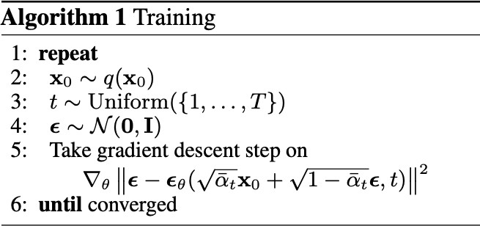
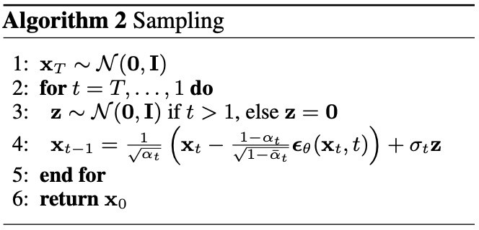
Summary
Training and Sample Generation

Slide 17



Implementation Considerations
Network Architectures
Diffusion models often use U-Net architectures with ResNet blocks and self-attention layers to represent
Time Representation
Fully-connected Layers
Time representation: sinusoidal positional embeddings or random Fourier features.
Time features are fed to the residual blocks using either simple spatial addition or using adaptive group normalization layers. (see Dharivwal and Nichol NeurIPS 2021)

Slide 18
Outline
Part (1): Denoising Diffusion Probabilistic Models
Part (2): Score-based Generative Modeling with Differential Equations
Part (3): Accelerated Sampling
Part (4): Conditional Generation and Guidance

Slide 19
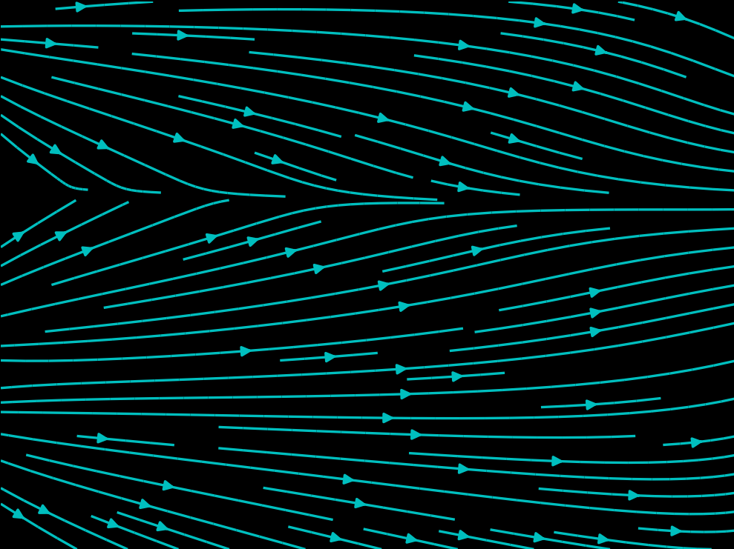
Crash Course in Differential Equations
Ordinary Differential Equation (ODE):
dx
= f (x, t) or
dx = f (x, t)dt
dt
t

Slide 20
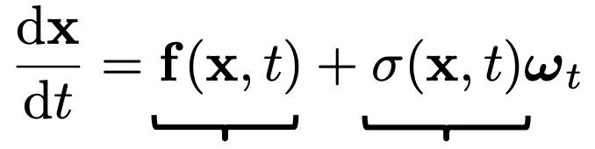
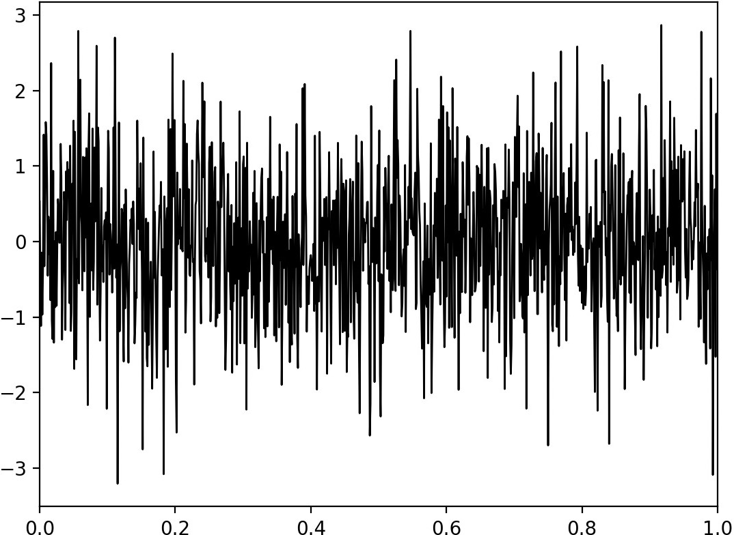
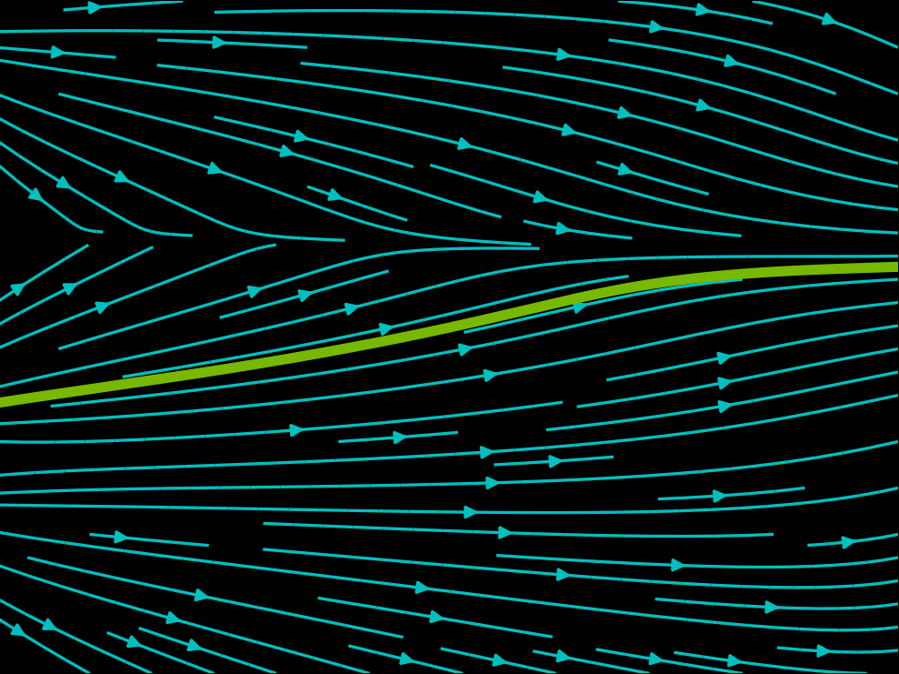
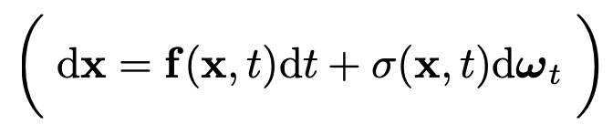
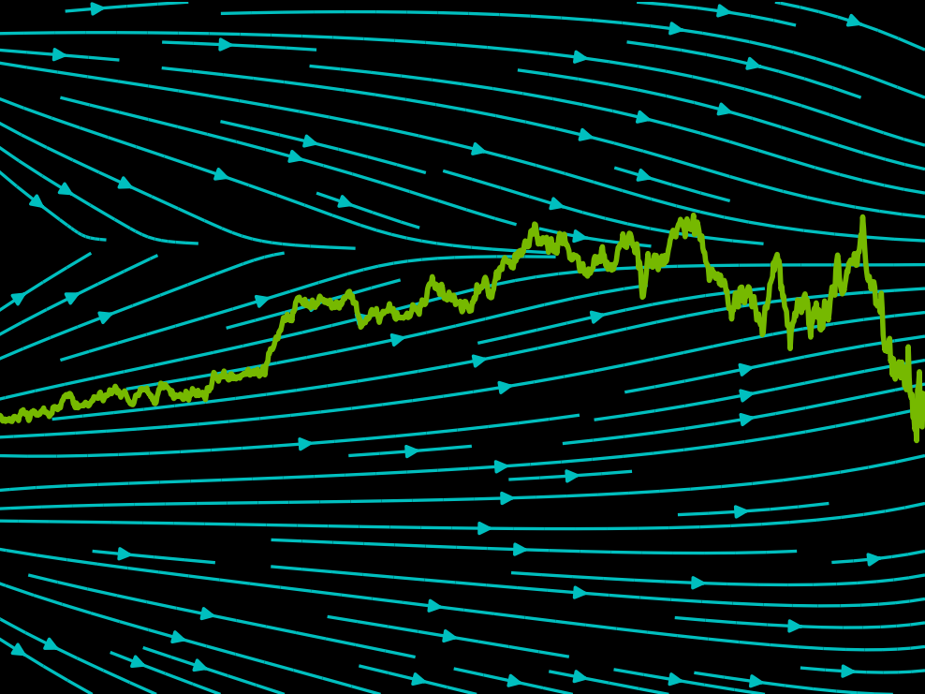
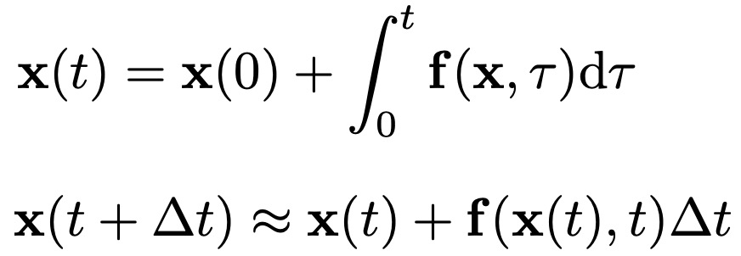
Crash Course in Differential Equations
Ordinary Differential Equation (ODE):
Stochastic Differential Equation (SDE):
dx
Wiener Process (Gaussian White Noise)
= f (x, t) or
dx = f (x, t)dt
dt
x
drift coefficient diffusion coefficient
r_{t}
t
Analytical Solution:
Iterative Numerical
t
Solution:

Slide 21

Crash Course in Differential Equations
Ordinary Differential Equation (ODE):
Stochastic Differential Equation (SDE):
dx
Wiener Process (Gaussian White Noise)
= f (x, t) or
dx = f (x, t)dt
dt
x
drift coefficient diffusion coefficient
r_{t}
t
Analytical Solution:
Iterative Numerical
Solution:

Slide 22

Forward Diffusion Process as Stochastic Differential Equation
Consider the limit of many small steps:
Forward diffusion process (fixed)
Data
Noise
x₀
x₁
x₂
x₃
x₄
…
x_{T}
Song et al., “Score-Based Generative Modeling through Stochastic Differential Equations”, ICLR, 2021
30

Slide 23






Forward Diffusion Process as Stochastic Differential Equation
Forward diffusion process (fixed)
q(x₀)
q(x_{T} )
x₀
…
x_{t}
…
x_{T}
Forward Diffusion SDE:
Song et al., ICLR, 2021
31

Slide 24

The Generative Reverse Stochastic Differential Equation
Forward diffusion process (fixed)
q(x₀)
q(x_{T} )
… …
x_{T}
x₀ x_{t}
Forward Diffusion SDE:
But what about the reverse direction, necessary for generation?
Song et al., ICLR, 2021
33

Slide 25

The Generative Reverse Stochastic Differential Equation
Forward diffusion process (fixed)
q(x₀)
q(x_{T} )
… …
x_{T}
x₀ x_{t}
Forward Diffusion SDE:
Reverse Generative Diffusion SDE:
Simulate reverse diffusion process: Data generation from random noise!
Song et al., ICLR, 2021
Anderson, in Stochastic Processes and their Applications, 1982
34

Slide 26


The Generative Reverse Stochastic Differential Equation
But how to get the score function ?
Forward Diffusion SDE:
Reverse Generative Diffusion SDE:
Simulate reverse diffusion process: Data generation from random noise!
Song et al., ICLR, 2021
Anderson, in Stochastic Processes and their Applications, 1982

Slide 27

Score Matching
Forward diffusion process (fixed)
q(x₀)
q(x_{T} )
… …
x_{T}
x₀ x_{t}
Naïve idea, learn model for the score function by direct regression?
Vincent, “A Connection Between Score Matching and Denoising Autoencoders”, Neural Computation, 2011 Song and Ermon, “Generative Modeling by Estimating Gradients of the Data Distribution”, NeurIPS, 2019
38

Slide 28


Denoising Score Matching
Forward diffusion process (fixed)
q(x₀)
q(x_{T} )
x
… …
x
x
T
0 t
Instead, diffuse individual data points x0. Diffused qt(xt|x0) is tractable!
Denoising Score Matching:
Vincent, in Neural Computation, 2011 Song and Ermon, NeurIPS, 2019 Song et al. ICLR, 2021
39

Slide 29

Denoising Score Matching
Forward diffusion process (fixed)
“Variance Preserving” SDE:
dx = — ¹ β(t)x dt + ^{p}β(t) dr
q(x₀)
q(x_{T} )
t t
t
2
x
… …
x
q_{t}(x_{t}|x₀) = N (x_{t}; ц_{t}x₀, σ²I)
x
T
t
0 t
Instead, diffuse individual data points x0. Diffused qt(xt|x0) is tractable!
Denoising Score Matching:
Vincent, in Neural Computation, 2011 Song and Ermon, NeurIPS, 2019 Song et al. ICLR, 2021
Same objectives in Part (1)!
40

Slide 30
Different Parameterizations
Noise prediction network:
Denoising network:
v-prediction:
44
More sophisticated model parametrizations and loss weightings possible!
Karras et al., "Elucidating the Design Space of Diffusion-Based Generative Models", NeurIPS 2022

Slide 31






Synthesis with SDE vs. ODE
q(x₀)
Generation with Reverse Diffusion SDE
q(x_{T} )
q(x₀)
Generation with Probability Flow ODE
q(x_{T} )
x₀
…
x_{t}
…
x_{T}
x₀
…
x_{t}
…
x_{T}
Generative Reverse Diffusion SDE (stochastic):
Generative Probability Flow ODE (deterministic):
Song et al., ICLR, 2021
45

Slide 32


Probability Flow ODE
Diffusion Models as Neural ODEs
Encoding with Probability Flow ODE
q(x₀)
Generation with Probability Flow ODE
q(x_{T} )
x₀
… x_{t} … x_{T}
Enables use of advanced ODE solvers Deterministic encoding and generation
(semantic image interpolation, etc.)
Log-likelihood computation (instantaneous change of variables):
Chen et al., NeurIPS, 2018 Grathwohl, ICLR, 2019
Song et al., ICLR, 2021
47

Slide 33
Outline
Part (1): Denoising Diffusion Probabilistic Models
Part (2): Score-based Generative Modeling with Differential Equations
Part (3): Accelerated Sampling
Part (4): Conditional Generation and Guidance
48

Slide 34

What makes a good generative model?
The generative learning trilemma
Likelihood-based models (Variational Autoencoders & Normalizing flows)
Fast Sampling
Mode Coverage/ Diversity
Generative Adversarial Networks (GANs)
Denoising Diffusion Models
High Quality Samples
Often requires 1000s of network evaluations!
Tackling the Generative Learning Trilemma with Denoising Diffusion GANs, ICLR 2022

Slide 35

What makes a good generative model?
The generative learning trilemma
Tackle the trilemma by accelerating diffusion models
Fast Sampling
Mode Coverage/ Diversity
High Quality Samples
Tackling the Generative Learning Trilemma with Denoising Diffusion GANs, ICLR 2022

Slide 36
Acceleration Techniques
Advanced ODE/SDE
Solvers
Low-dim. Diffusion Processes
Advanced Diffusion Processes
Distillation Techniques
Forward diffusion process (fixed)
q(x₀)
q(x_{T} )

Slide 37
Acceleration Techniques
Advanced ODE/SDE
Solvers
Low-dim. Diffusion Processes
Advanced Diffusion Processes
Distillation Techniques

Slide 38




Generative ODEs
Solve ODEs with as little function evaluations as possible
ODE Trajectories

Slide 39




Generative ODEs
Solve ODEs with as little function evaluations as possible
First Truncated Taylor method (Euler Method)
ODE Trajectories
Song et al., "Denoising Diffusion Implicit Models (DDIM)", ICLR 2021

Slide 40




Generative ODEs
Solve ODEs with as little function evaluations as possible
First Truncated Taylor method (Euler Method)
Higher order methods (RK4, Multistepping, Heun)
ODE Trajectories
Approximate the higher order terms numerically

Slide 41
A Rich Body of Work on ODE/SDE Solvers for Diffusion Models
Runge-Kutta adaptive step-size ODE solver:
  Song et al., “Score-Based Generative Modeling through Stochastic Differential Equations”, ICLR, 2021
Higher-Order adaptive step-size SDE solver:
  Jolicoeur-Martineau et al., “Gotta Go Fast When Generating Data with Score-Based Models”, arXiv, 2021
Reparametrized, smoother ODE:
  Song et al., “Denoising Diffusion Implicit Models”, ICLR, 2021
  Zhang et al., "gDDIM: Generalized denoising diffusion implicit models", arXiv 2022
Higher-Order ODE solver with linear multistepping:
  Liu et al., “Pseudo Numerical Methods for Diffusion Models on Manifolds”, ICLR, 2022
Exponential ODE Integrators:
  Zhang and Chen, “Fast Sampling of Diffusion Models with Exponential Integrator”, arXiv, 2022
  Lu et al., “DPM-Solver: A Fast ODE Solver for Diffusion Probabilistic Model Sampling in Around 10 Steps”, NeurIPS, 2022
  Lu et al., "DPM-Solver++: Fast Solver for Guided Sampling of Diffusion Probabilistic Models", NeurIPS 2022
Higher-Order ODE solver with Heun’s Method:
  Karras et al., “Elucidating the Design Space of Diffusion-Based Generative Models”, NeurIPS, 2022
Many more:
  Zhao et al., "UniPC: A Unified Predictor-Corrector Framework for Fast Sampling of Diffusion Models", arXiv 2023
  Shih et al., "Parallel Sampling of Diffusion Models", arxiv 2023
  Chen et al., "A Geometric Perspective on Diffusion Models", arXiv 2023

Slide 42
Acceleration Techniques
Advanced ODE/SDE
Solvers
Low-dim. Diffusion Processes
Advanced Diffusion Processes
Distillation Techniques

Slide 43



ODE Distillation
q(x₀)
Generation with Reverse Diffusion SDE
q(x_{T} )
Can we train a neural network to directly predict
given ?

Slide 44

Progressive Distillation
Distill a deterministic ODE sampler to the same model architecture.
At each stage, a “student” model is learned to distill two adjacent sampling steps of the “teacher” model to one sampling step.
At next stage, the “student” model from previous stage will serve as the new “teacher” model.
Distillation stage
Salimans & Ho, “Progressive distillation for fast sampling of diffusion models”, ICLR 2022.

Slide 45

Progressive Distillation in Latent Space
Meng et al., "On Distillation of Guided Diffusion Models", CVPR 2023 (Award Candidate)

Slide 46




Consistency Distillation
Points on the same trajectory should generated the same Assume is the current estimation of
Basic idea:
Find and on a trajectory by solving generative ODE in
Minimize:
Song et al., Consistency Models, ICML 2023

Slide 47

SDE Distillation
q(x₀)
Generation with Reverse Diffusion SDE
q(x_{T} )
Can we train a neural network to directly predict distribution of
given ?
65

Slide 48

Advanced Approximation of Reverse Process
Normal assumption in denoising distribution holds only for small step
Denoising Process with Uni-modal Normal Distribution
Data
Noise
Data
Noise
GANs used by Xiao et al.
Requires more complicated functional approximators!
Xiao et al., “Tackling the Generative Learning Trilemma with Denoising Diffusion GANs”, ICLR 2022. Gao et al., “Learning energy-based models by diffusion recovery likelihood”, ICLR 2021.
Energy-based models by Gao et al.
66

Slide 49
Training-based Sampling Techniques
Knowledge distillation:
  Luhman and Luhman, Knowledge Distillation in Iterative Generative Models for Improved Sampling Speed, arXiv 2021
Learned Samplers:
  Watson et al., "Learning Fast Samplers for Diffusion Models by Differentiating Through Sample Quality", ICLR 2022
Neural Operators:
  Zheng et al., Fast Sampling of Diffusion Models via Operator Learning, ICML 2023
Wavelet Diffusion Models:
  Phung et al., "Wavelet Diffusion Models Are Fast and Scalable Image Generators", CVPR 2023
Distilled ODE Solvers:
  Dockhorn et al., "GENIE: Higher-Order Denoising Diffusion Solvers", NeurIPS 2022

Slide 50
Acceleration Techniques
Advanced ODE/SDE
Solvers
Low-dim. Diffusion Processes
Advanced Diffusion Processes
Distillation Techniques

Slide 51

Cascaded Generation
Pipeline
Cascaded Diffusion Models outperform Big-GAN in FID and IS and VQ-VAE2 in Classification Accuracy Score.
Ho et al., “Cascaded Diffusion Models for High Fidelity Image Generation”, 2021.
Ramesh et al., “Hierarchical Text-Conditional Image Generation with CLIP Latents”, arXiv 2022.
Saharia et al., “Photorealistic Text-to-Image Diffusion Models with Deep Language Understanding”, arXiv 2022.
69

Slide 52



























Latent Diffusion Models
Variational autoencoder + score-based prior
Encoder
Latent Space Forward Diffusion
Data
Reconst.
Decoder
Latent Space Generative Denoising
Variational Autoencoder
Denoising Diffusion Prior
Main Idea
Encoder maps the input data to an embedding space Denoising diffusion models are applied in the latent space
Vahdat et al., “Score-based generative modeling in latent space”, NeurIPS 2021.

Slide 53
Latent Diffusion Models
Variational autoencoder + score-based prior
Encoder
Latent Space Forward Diffusion
Data
Reconst.
Decoder
Latent Space Generative Denoising
Variational Autoencoder
Denoising Diffusion Prior
Advantages:
The distribution of latent embeddings close to Normal distribution → Simpler denoising, Faster synthesis!
Latent space → More expressivity and flexibility in design!
Tailored Autoencoders → More expressivity, Application to any data type (graphs, text, 3D data, etc.) !
Vahdat et al., “Score-based generative modeling in latent space”, NeurIPS 2021.

Slide 54

Latent Diffusion Models
End-to-End Training objective
Vahdat et al., “Score-based generative modeling in latent space”, NeurIPS 2021.

Slide 55
Latent Diffusion Models
Two-stage Training
Encoder
Latent Space Forward Diffusion
Data
Reconst.
Decoder
Latent Space Generative Denoising
The seminal work from Rombach et al. CVPR 2022:
Two stage training: train autoencoder first, then train the diffusion prior
Focus on compression without of any loss in reconstruction quality
Demonstrated the expressivity of latent diffusion models on many conditional problems
The efficiency and expressivity of latent diffusion models + open-source access fueled a large body of work in the community
Rombach et al., “High-Resolution Image Synthesis with Latent Diffusion Models”, CVPR 2022.

Slide 56
Additional Reading
More on low-dimensional diffusion models:
Sinha et al., "D2C: Diffusion-Denoising Models for Few-shot Conditional Generation", NeurIPS 2021
Daras et al., "Score-Guided Intermediate Layer Optimization: Fast Langevin Mixing for Inverse Problems", ICML 2022
Zhang et al., “Dimensionality-Varying Diffusion Process”, arXiv 2022.

Slide 57
Acceleration Techniques
Advanced ODE/SDE
Solvers
Low-dim. Diffusion Processes
Advanced Diffusion Processes
Distillation Techniques

Slide 58


ODE interpretation
Deterministic generative process
DDIM sampler can be considered as an integration rule of the following ODE:
Karras et al. argue that the ODE of DDIM is favored, as the tangent of the solution trajectory always points towards the denoiser output.
This leads to largely linear solution trajectories with low curvature → Low curvature means less truncation errors accumulated over the trajectories.
Song et al., “Denoising Diffusion Implicit Models”, ICLR 2021.
Karras et al., “Elucidating the Design Space of Diffusion-Based Generative Models”, arXiv 2022. Salimans & Ho, “Progressive distillation for fast sampling of diffusion models”, ICLR 2022.
76

Slide 59

“Momentum-based” diffusion
Introduce a velocity variable and run diffusion in extended space
Main idea: Inject noise only into vt, faster mixing through Hamiltonian component!
Dockhorn et al., “Score-Based Generative Modeling with Critically-Damped Langevin Diffusion”, ICLR 2022.
77

Slide 60
Additional Reading
Schrödinger Bridge:
  Bortoli et al., "Diffusion Schrödinger Bridge", NeurIPS 2021
  Chen et al., “Likelihood Training of Schrödinger Bridge using Forward-Backward SDEs Theory”, ICLR 2022
Diffusion Processes on Manifolds:
  Bortoli et al., "Riemannian Score-Based Generative Modelling", NeurIPS 2022
Cold Diffusion:
  Bansal et al., "Cold Diffusion: Inverting Arbitrary Image Transforms Without Noise", arXiv 2022
Diffusion for Corrupted Data:
  Daras et al., "Soft Diffusion: Score Matching for General Corruptions", TMLR 2023
  Delbracio and Milanfar, "Inversion by Direct Iteration: An Alternative to Denoising Diffusion for Image Restoration", arXiv 2023
  Luo et al., "Image Restoration with Mean-Reverting Stochastic Differential Equations", ICML 2023
  Liu et al., “I2SB: Image-to-Image Schrödinger Bridge”, ICML 2023
Blurring Diffusion Process:
  Hoogeboom and Salimans, "Blurring Diffusion Models", ICLR 2023
  Rissanen et al, “Generative Modelling With Inverse Heat Dissipation”, ICLR 2023

Slide 61
Outline
Part (1): Denoising Diffusion Probabilistic Models
Part (2): Score-based Generative Modeling with Differential Equations Part (3): Accelerated Sampling
Part (4): Conditional Generation and Guidance

Slide 62


Impressive Conditional Diffusion Models
Text-to-image generation
DALL·E 2
“a propaganda poster depicting a cat dressed as french emperor napoleon holding a piece of cheese”
IMAGEN
“A photo of a raccoon wearing an astronaut helmet, looking out of the window at night.”
Ramesh et al., “Hierarchical Text-Conditional Image Generation with CLIP Latents”, arXiv 2022.
Saharia et al., “Photorealistic Text-to-Image Diffusion Models with Deep Language Understanding”, arXiv 2022.
80

Slide 63
Conditioning and Guidance Techniques
Classifier- free Guidance
Explicit Conditions
Classifier Guidance

Slide 64
Conditioning and Guidance Techniques
Classifier- free Guidance
Explicit Conditions
Classifier Guidance

Slide 65





Explicit Conditional Training
Conditional sampling can be considered as training output (e.g., image)
where y is the input conditioning (e.g., text) and x is generated
Train the score model for x conditioned on y using:
The conditional score is simply a U-Net with x_{t} and y together in the input.

Slide 66
Conditioning and Guidance Techniques
Classifier- free Guidance
Explicit Conditions
Classifier Guidance

Slide 67



Classifier Guidance: Bayes’ Rule in Action
Recall that when sampling from a conditional model
we basically need an estimation of
Classifier gradient
Score model
Using Bayes’ rule, we have:
Introduce a guidance scale (w):
Song et al., “Score-Based Generative Modeling through Stochastic Differential Equations”, ICLR, 2021
Nie et al., “Controllable and Compositional Generation with Latent-Space Energy-Based Models”, NeurIPS 2021 Dhariwal and Nichol, “Diffusion models beat GANs on image synthesis”, NeurIPS 2021.
85

Slide 68
Conditioning and Guidance Techniques
Classifier- free Guidance
Explicit Conditions
Classifier Guidance
86

Slide 69
Classifier-free guidance
Get guidance by Bayes’ rule on conditional diffusion models
Recall that classifier guidance requires training a classifier.
Using Bayes’ rule again:
Conditional diffusion model
Unconditional diffusion model
Instead of training an additional classifier, get an “implicit classifier” by jointly training a conditional and unconditional diffusion model. In practice, the conditional and unconditional models are trained together by randomly dropping the condition of the diffusion model at certain chance.
The modified score with this implicit classifier included is:
Ho & Salimans, “Classifier-Free Diffusion Guidance”, 2021.

Slide 70



Classifier-free guidance
Trade-off for sample quality and sample diversity
Non-guidance
𝜔 = 1 𝜔 = 3
Large guidance weight (𝜔) usually leads to better individual sample quality but less sample diversity.
Ho & Salimans, “Classifier-Free Diffusion Guidance”, 2021.

Slide 71
Summary
We reviewed diffusion fundamentals in 4 parts:
Discrete-time diffusion models
Continuous-time diffusion models
Accelerated sampling from diffusion models
Guidance and conditioning.

Slide 72
Thank You!

